Slide 1
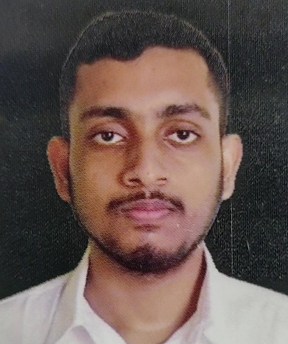

Rupayan Bhattacharjee
Analyst/Software Engineer
Bachelor of Engineering
Computer Science : 2018 - 2022
Skills
C# | C# Basics,OOPS,Generics,Collections,Array,Loops
.NET | ADO.NET,ASP.NET with MVC and WEBAPI ,Entity Framework
.NETCORE | ASP.NETCORE MVC , .NETCORE WEBAPI wiith Entity Framework
Angular | Components, Services, Modules, Routing, Forms & Validation,Exception Handling
Database | Microsoft SQL Server
UI Tech | HTML5 & CSS3, Javascript,Basic UI Design
Cloud | Microsoft AZ 900 ongoing Training
Tools | Git,Postman,SSMS,Visual Studio,Visual Studio Code
Mumbai
rupayan.bhattacharjee@capgemini.com
+91 8724993827
A4
Full Stack Developer
Hands on experience on C#,ADO.NET ,SQL Server,.NET MVC with WEBAPI ,ANGULAR and ASP.NETCORE WEBAPI.
Proficient in creating Single page Web Application in Angular With ASP.NET COREWEBAPI
Hands on experience in developing web pages using HTML5,CSS3,Object Oriented Java script
Experience in creating documentation with Java docs and swagger.
Having Knowledge of Git and GitHub
Attended training on .NET and .NETCORE
Online Hotel Management System
Case study of Online Hotel Management System developed using ASP.NET Core ,Web API Core ,SQL Server Management Studio and UserInterface created with HTML5,CSS3 and Angular. JWT authentication was used for user authentication purposes. It is a web application whose end user is the owner of the hotel and certain staffs like manager and receptionist of the hotel. This web application is meant to automate major operations of the hotel including functionalities like keeping track of all the rooms and their availability status, inventory details and the list of guests residing in those rooms.

